Slide 1
Pthread & OpenMP
Parallel Programming Lab2-2
Oct 20 2022

Slide 2
Lab2 Tasks
We are going to approximate pixels using pthread, OpenMP and hybrid of MPI and OpenMP in this lab ---
Deadline of the Lab2 is 10/27 23:59
All sample codes and test cases are provided at /home/pp22/share/lab2
testcases_1 is for practice 1, testcases_2 is for practice 2, and so on.
Check your codes with lab2_pthread-judge、lab2_omp-judge、lab2_hybrid-judge
Scoreboard: pthread, OpenMP, hybrid
Hand in your code(three files) to eeclass. TA will check your code after deadline.

Slide 3
SLURM quick reference
srun [flags] ./prog ============ or ============ #!/bin/bash #SBATCH [flags] srun ./prog # (MPI) ./prog # (non-MPI) --------- run with: -------- sbatch job.sh
[flags]: -N number of nodes -n number of processes -c CPUs per process -t additional time limit -J name of job

Slide 4
Outline
Pthread
Hello world
Mutex
OpenMP
MPI + OpenMP

Slide 5
Running pthread programs on apollo
SYNOPSIS #include <pthread.h> int pthread_create( pthread_t *thread, const pthread_attr_t *attr, void *(*start_routine) (void *), void *arg); Compile and link with -pthread.
Type `man pthread_create` in terminal to see this

Slide 6
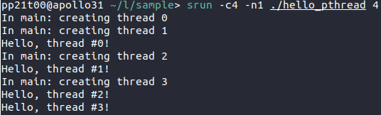
Running pthread programs on apollo
Example code
/home/pp22/share/lab2/sample/hello_pthread.cc
Compile g++ hello_pthread.cc -o hello_pthread -pthread
Execute srun -c4 -n1 ./hello_pthread 4 -c4 means 4 CPUs per process -n1 means 1 process You can use sbatch as well!
NOT -lpthread

Slide 7
Outline
Pthread
Hello world
Mutex
OpenMP
MPI + OpenMP

Slide 8
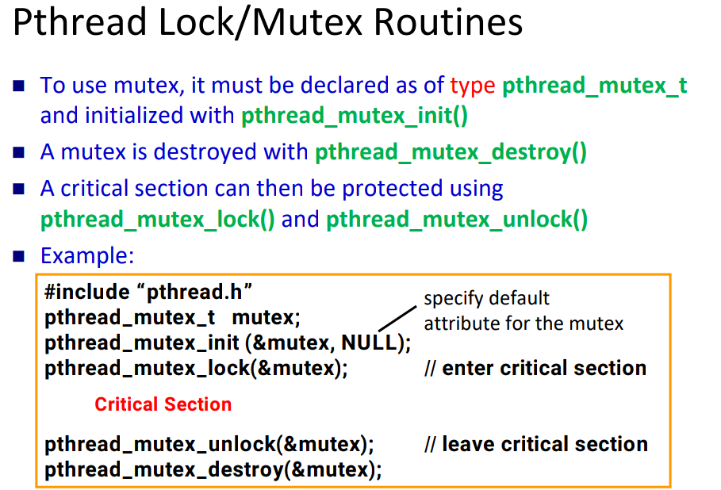

Slide 9
Mutex
man pthread_mutex_init
#include <pthread.h> pthread_mutex_t mutex = PTHREAD_MUTEX_INITIALIZER;
int pthread_mutex_lock(pthread_mutex_t *mutex); int pthread_mutex_trylock(pthread_mutex_t *mutex); int pthread_mutex_unlock(pthread_mutex_t *mutex);
man pthread_mutex_lock

Slide 10
[Practice 1] Approximate pixels using pthread
⭐ Modify the sequential code lab2_pthread.cc with pthread
[example commands]
g++ lab2_pthread.cc -o lab2_pthread -pthread -lm
srun -c4 -n1 ./lab2_pthread r k
You can also use Makefile to compile your code!

Slide 11
Outline
Pthread
Hello world
Mutex
OpenMP
MPI + OpenMP

Slide 12

Running OpenMP programs on apollo
Example code
hello_omp.cc
Compile g++ hello_omp.cc -o hello_omp -fopenmp
Execute srun -c4 -n1 ./hello_omp Try different number of threads!
OpenMP automatically detects number of CPUs from SLURM (affinity)
So we don’t have to specify it again

Slide 13
[Practice 2] Approximate pixels using OpenMP
⭐ Modify the sequential code lab2_omp.cc with OpenMP
⭐ Try yourself to see the effect of changing ✦ dynamic/static scheduling ✦ chunk size ✦ number of threads
[example commands] g++ lab2_omp.cc -o lab2_omp -fopenmp -lm srun -c4 -n1 ./lab2_omp r k

Slide 14
Outline
Pthread
Hello world
Mutex
OpenMP
MPI + OpenMP

Slide 15
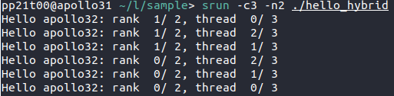
Running Hybrid MPI and OpenMP programs on apollo
Example code
hello_hybrid.cc
Compile mpicxx hello_hybrid.cc -o hello_hybrid -fopenmp
Execute srun -c3 -n2 ./hello_hybrid
We’re using OpenMP
We’re using MPI
3 threads
2 processes

Slide 16
[Practice 3] Approximate pixels using MPI and OpenMP
⭐ Modify the sequential code lab2_hybrid.cc with MPI and OpenMP
✦ You can refer to your code in lab1!
[example commands] mpicxx lab2_hybrid.cc -o lab2_hybrid -fopenmp -lm srun -N2 -n6 -c4 ./lab2_hybrid r k

